Slide 1



Presented by
K.LAVANYA(927621bec101)
Guided by
Dr.M.DHAMODARAN

Slide 2
CONTENT:
►Reconfigurable intelligent surface.
►Software used.
►Principles.
►Method used in ANSYS.
►Material used in ANSYS.
►Advantages and Disadvantages in (RIS).

Slide 3
RECONFIGURABLE INTELLIGENT SURFACE:
RECONFIGURABLE : Properties can be changed.
INTELLIGENT : Real time programmable/controllable.
SURFACE : Two dimensional array of scatterers.

Slide 4
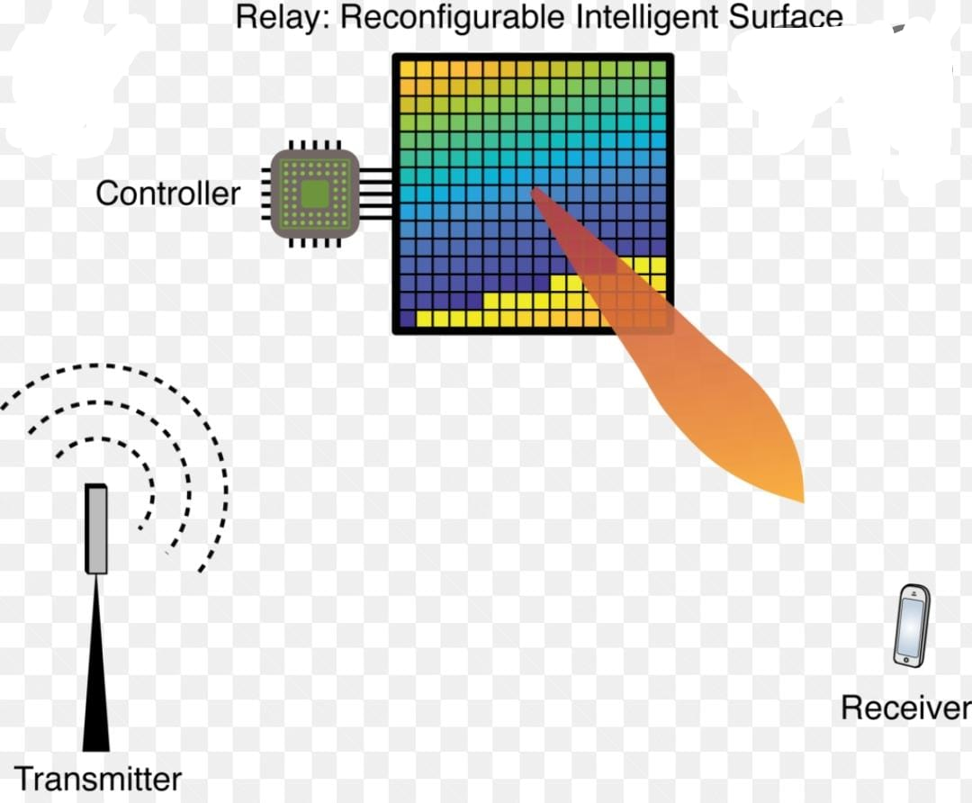
SOFTWARE NAME:
ANSYS ELECTRONICS DESKTOP STUDENT(EDT)

Slide 5
APPLICATION OF RECONFIGURABLE INTELLIGENT SURFACE(RIS):
Reconfigurable Intelligent Surfaces (RIS) is envisaged as a new enabling candidate wireless technology for the control of the radio signals between a transmitter and a receiver in a dynamic and goal-oriented way, turning the wireless environment into a service.

Slide 6
Which companies uses Ansys?
► List of companies using Ansys includes ABB, Alstom, Blue Origin, Raytheon, Delphi, Ford, GE, Kirloskar, Whirlpool, Reliance Infrastructure
The Ansys Clients list covers over 250 large scale businesses from
all corners of the map.
And the price of ANSYS software is Rs. 15 lakh to Rs. 30 lakh.
ANSYS stand for▬ Analysis System

Slide 7

PHYSICS OF WIRELESS SIGNAL PROPAGATION:
► Electromagnetic travel a speed of light.
►Spread out in all direction.
► Friis’s propagation formula,
●RECEIVE POWER=TRANSMIT POWER.A/4$πd^{2}$

Slide 8
MEANS OF RECONFIGURABILITY:
● Tuning impedance.
● Tuning length of delay lines.
● Phase-shifters.
RIS as a whole can control • Directivity of scattered signal
• Signal absorption.
● Polarization.

Slide 9
PRINCIPLES:
An intelligent reflecting surface (IRS) is a programmable device that can be used to control electromagnetic waves propagation by changing the electric and magnetic properties of its surface.
• Therefore, IRS is considered a smart technology for the sixth generation (6G) of communication networks.

Slide 10
How reconfigurable intelligent surfaces work?
Reconfigurable intelligent surface (RIS) is a programmable structure that can be used to control the propagation of electromagnetic waves by changing the electric and magnetic properties of the surface.
► By placing these surfaces in an environment, the properties of radio channels
can be controlled.
Reconfigurable Intelligent Surfaces (RIS) is envisaged as a new enabling candidate wireless technology for the control of the radio signals between a transmitter and a receiver in a dynamic and goal-oriented way, turning the wireless environment into a service.

Slide 11
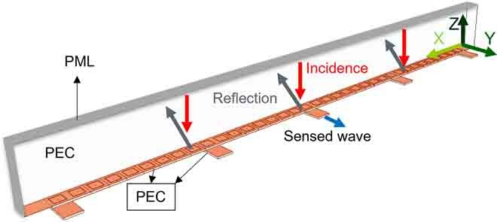

Slide 12
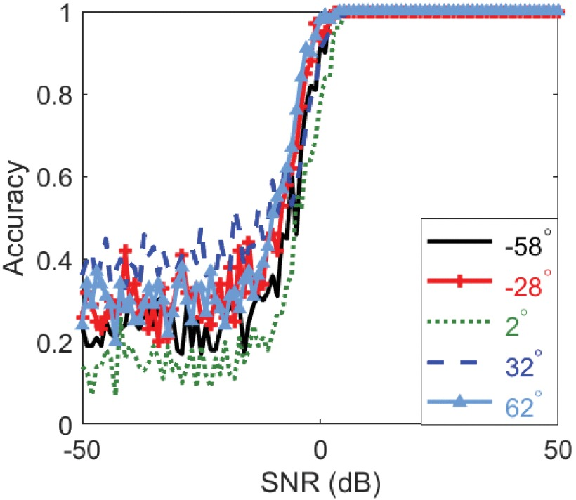
ACCURACY OF DETECTION:
The accuracy of AoA estimation in the proposed problem formulation is dependent upon the resolution of our sensing matrix which is 5 degree.
We used this angular resolution which is slightly smaller
than the broadside HPBW of a uniform antenna array of
the same size as the RIS.
► It should be noted that the HPBW is larger for off-
broadside incidence.

Slide 13
Which method is used in ANSYS?
MultiZone Meshing Method, based on blocking approach used in ANSYS ICEM CFD Hexa.
It automatically generates a pure hexahedral mesh where possible and then fills the more difficult to capture regions with unstructured mesh.

Slide 14
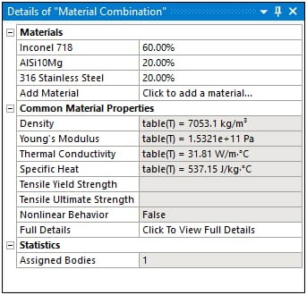
What materials are in ANSYS?
Broad coverage of materials classes:
♦ Metals
♦ Plastics
♦ Ceramics
♦ Fluids
♦ Semiconductors
♦ PCB laminates
♦ Magnetic materials
♦ Woods
♦ Composites
♦ Glasses and
♦ Foams.

Slide 15
Advantages of Reconfigurable Intelligent Surface:
Metasurfaces outperform SISO (Single Input Single Output) system with same distance.
It offers better beamforming gain compare to massive MIMO (MULTIPLE INPUT AND MULTIPLE OUTPUT).
The received power is increased by factor 'N' in massive MIMO where as it is increased by factor 'N2' in RIS.

Slide 16
Disadvantages of Reconfigurable Intelligent Surface:
It does not outperform relay. To make performance similar to relay, requires metasurface with higher number of elements (~200).
RIS has worst SNR (Signal to Noise Ratio) than massive MIMO.
RIS elements do not support digital processing capability as it is designed based on concept of analog beamforming.

Slide 17
Conclusion:
Reconfigurable intelligent surface (RIS) is a programmable structure that can be used to control the propagation of electromagnetic waves by changing the electric and magnetic properties of the surface.
By placing these surfaces in an environment, the properties of radio channels can be controlled

Slide 18


